Slide 1


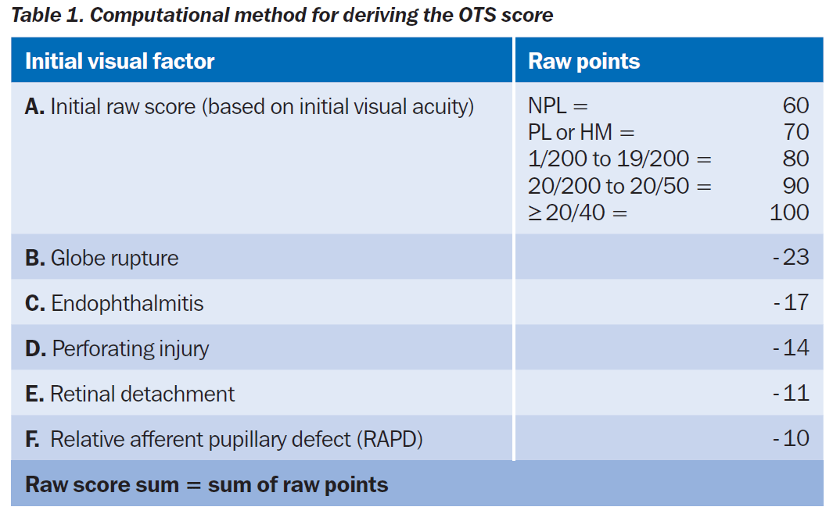
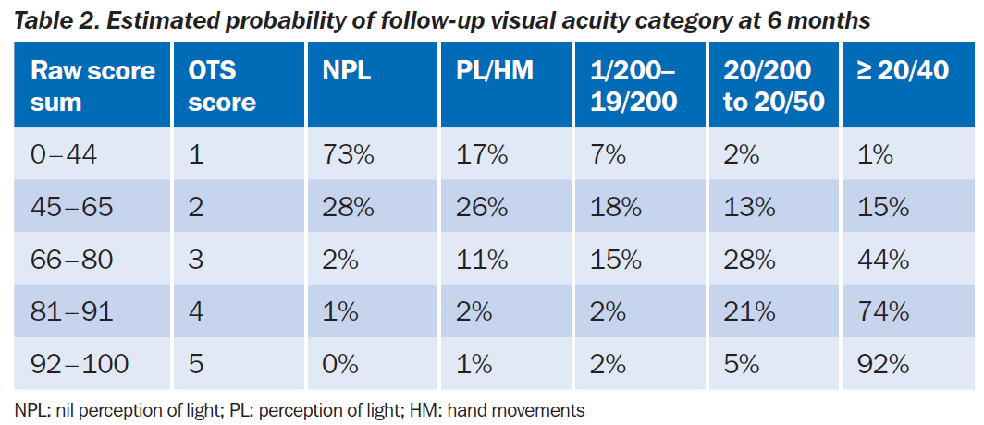
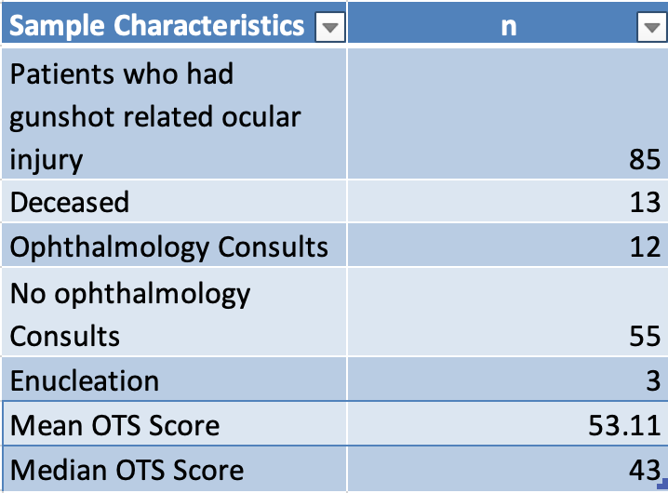
Clinical Features of Orbital and Ocular Gunshot Wounds
Vincent Tang, Matthew Allen De Niear, MD, PhD, Lily Koo Lin, MD
University of California Davis, School of Medicine, UC Davis Medical Center; Department of Ophthalmology
Introduction:
Ocular trauma is a leading cause of blindness in the United States. There have been studies of ocular trauma and penetrating injury, but few examining visual outcomes following gun related trauma to orbital and ocular structures. Furthermore, associations related to this type of trauma and visual outcomes has not been extensively studied.
Conclusions:
OTS can be used to predict visual outcomes related to gun injury
Gun-related trauma to the eye usually results in poor visual outcomes
OTS average of 53 correlates to a 28% probability of NPL and 26% probability of PL/HM.
Qualitatively, the limited data suggests that patients have little improvement or permanent vision loss after gun-related injury.
In cases that there is gun-related injury to the surrounding ocular structures, ophthalmology is rarely consulted. Neurosurgery, ENT, and Trauma Surgery are likely to be consulted instead.
Study Goals:
The aim of this study is to examine what factors of gun related trauma are predictive or associated with visual outcomes. For example, we will look at factors such as the ocular trauma score. The hope is to create a classification system that would allow objective assessment for both clinical prognosis and interventional studies.
Table 1. Ocular Trauma Score used to predict visual outcomes after ocular trauma.
Limitations:
Very small sample size (n=12).
Many patients did not survive a gunshot wound to the ocular area/head, making it difficult to obtain a larger sample size.
Few patients returned for follow up, giving limited information on visual outcomes
Due to time restrictions, we could not do a complete statistical analysis.
Experimental Design:
The design of the experiment was retrospective cohort study at a single academic center.
Included patients who had gun related trauma to the head and ocular area from 01/2010 to 09/2020, and they had an ophthalmology consult
Abstracted data from EMR, such as demographics, visual acuity, and features of the Ocular Trauma Score (OTS)
Calculated OTS and estimated probability of follow up visual acuity (Table 1-2).
Excluded patients that did not survive or had enucleations
Primary outcome = visual acuity change
Table 2. Estimated probability of follow up visual acuity based on OTS.
Future Goals:
Increase the sample size of the data by including more academic centers.
Broaden ocular trauma to include other, less lethal, causes.
Do a more thorough analysis using logmar to track visual acuity changes more objective.
Look for patients with longer follow up.
Results:
There was a very small sample size, but we were able to extract some limited information on the population characteristics and visual outcomes.
References:
Kuhn F, Maisiak R, Mann L, Mester V, Morris R, Witherspoon C (2002) The Ocular Trauma Score (OTS). Ophthalmol Clin North Am 15: 163−166
Kuhn F, Maisiak R, Mann L, Morris R, Witherspoon C (2002) The Ocular Trauma Score (OTS): Prognosticating the final vision of the seriously injured eye. In: Kuhn F, Pieramici D (eds) Ocular trauma: principles and practice. Thieme, New York, pp 14−12
Weichel ED1, Colyer MH, Ludlow SE, Bower KS, Eiseman AS. Combat ocular trauma visual outcomes during operations iraqi and enduring freedom. Ophthalmology. 2008 Dec;115(12):2235-45. doi: 10.1016/j.ophtha.2008.08.033.
Community eye health journal » the ocular trauma score. (n.d.). Community Eye Health Journal. https://s160131.gridserver.com/article/the-ocular-trauma-score/
Morgan, A. M., & Kasahara, N. (2018). Comparative evaluation of the prognostic value between the ocular trauma score and the pediatric penetrating ocular trauma score. Journal of Craniofacial Surgery, 29(7), 1776-1779. https://doi.org/10.1097/scs.0000000000004937
Table 3. Student survey on their desire to incorporate addition ultrasound education in the preclinical years.
Notes:
Specific Aims: Our project is an exploratory study designed to generate hypotheses about the beliefs and treatment practices for childhood diarrhea in Nicaragua.
We sought to answer the following questions:
Are there different beliefs about the causes of childhood diarrhea between rural and urban communities in Nicaragua?
Are there different treatment practices for childhood diarrhea between rural and urban communities in Nicaragua?
Are there different thresholds for seeking medical care for diarrhea between rural and urban communities?

